Slide 1



Implementation of Shannon Fano codec on Lab Images
Guided by
Dr.Merlin Gilbert
Aldrin G (Student)
Brijin G (Student)

Slide 2
Outline
Problem Statement
Introduction
Market Survey
Methodology
Results and Discussions
Conclusions
References
Acknowledgements

Slide 3
Problem Statement
"Laboratory imaging systems often produce large data files, leading to high storage and transmission costs. An effective compression method is required to reduce file sizes without compromising the quality needed for accurate analysis.”

Slide 4
Introduction
Shannon–Fano coding, named after Claude Shannon and Robert Fano in the year 1949.
Our project is to Implement Shanon Fano encoding on RGB images but we extended it to medical images which uses DICOM format to explore further capabilities of it.
The aim of the project is to reduce the file size of the image but preserving quality for faster transmission and efficient hardware usage by using lossless encoding technique which assigns shorter codes to more frequently occurring color combinations.
This Project also focusses on making a on study on the capabilities of Shannon Fano encoding by displaying each step of the process and visualizing different parameters such as entropy, avg code word length, efficiency and PSNR ratio using graphs and charts

Slide 5
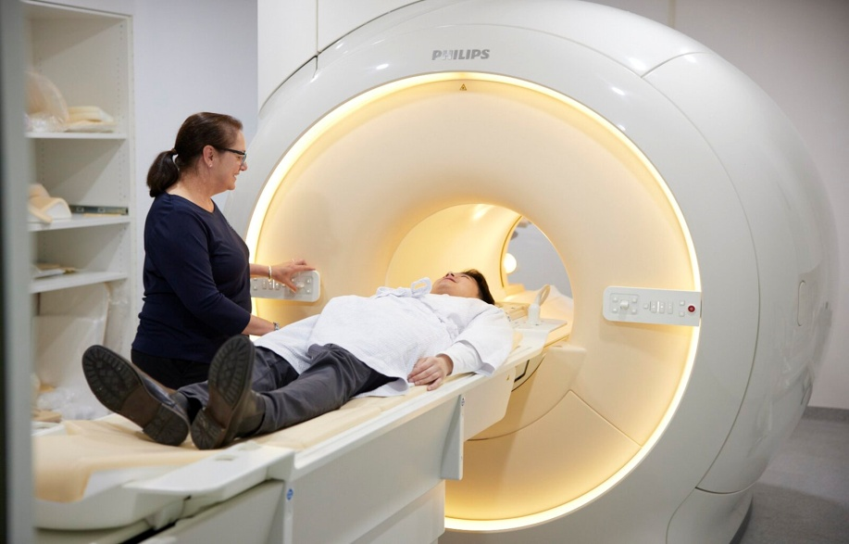
Market Survey
Target Sectors:
Hospitals and Medical Centers, Radiology Departments,
Medical Device Manufacturers
Current Challenges:
Very large Data Volume, High Storage Costs,
Image Quality Preservation
Current Compression Techniques:
JPEG2000 and Lossless JPEG: Widely used, particularly in DICOM, but they have limitations in terms of computational efficiency and compression ratio.
Other Coding Techniques: Often used but could be inefficient for certain types of data.
Proprietary Compression Algorithms: Some organisations use their own compression techniques, making integration with other systems difficult.

Slide 6
Market Survey
Shannon-Fano Encoding as a Solution:
Efficiency in Compression: Shannon-Fano offers a method of entropy-based compression that may provide better compression ratios for certain types of medical images without significant loss.
Cost-Effective: May reduce storage and transmission costs when handling large DICOM and RAW image datasets.
Computational Requirements: Its lightweight computational nature might make it suitable for integration into real-time or near-real-time medical imaging systems.

Slide 7


Methodology to implement Shannon-Fano Coding

Slide 8
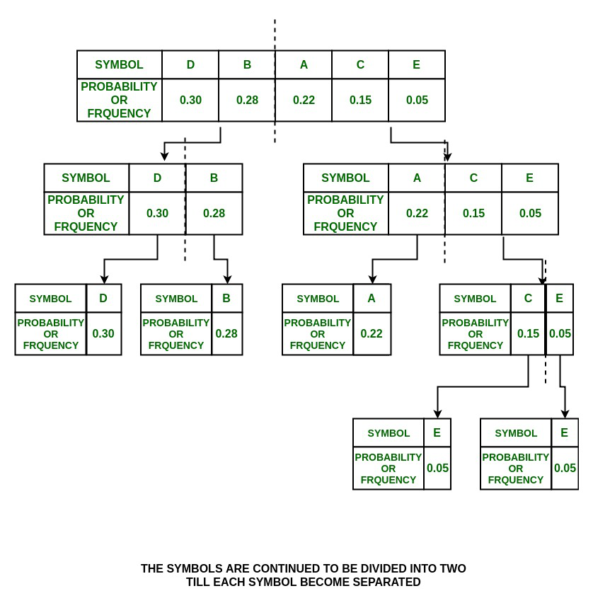
Methodology
Working of Shannon Fano Encoding:

Slide 9

Metrics for Shannon-Fano Encoding

Slide 10
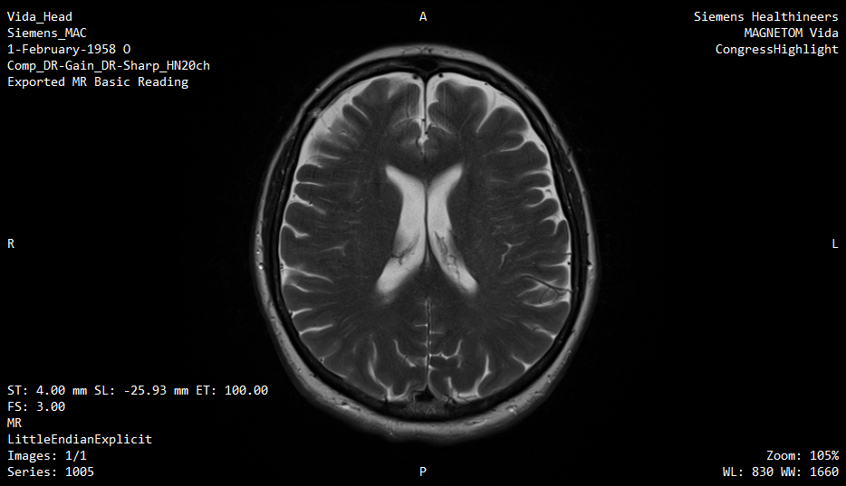
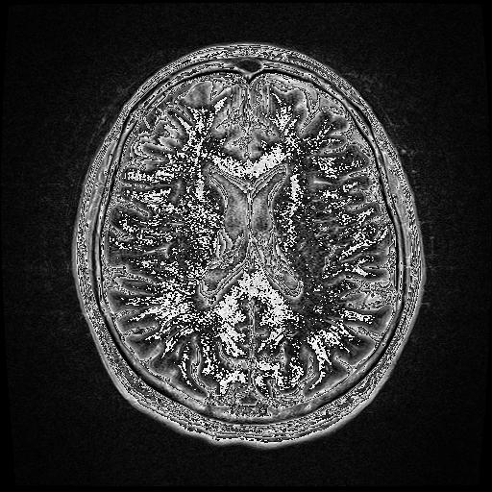
Results and Discussions
Original DICOM Image
Decoded as JPEG after Encoding
using Shannon-Fano

Slide 11
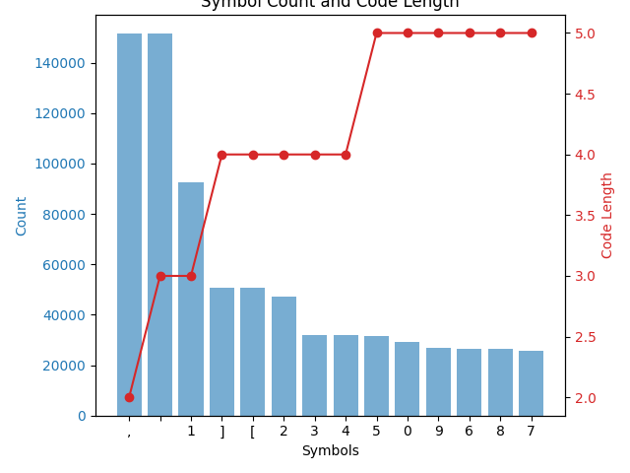
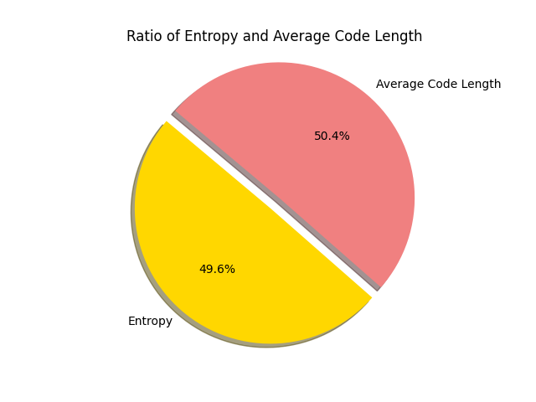
Results and Discussions

Slide 12
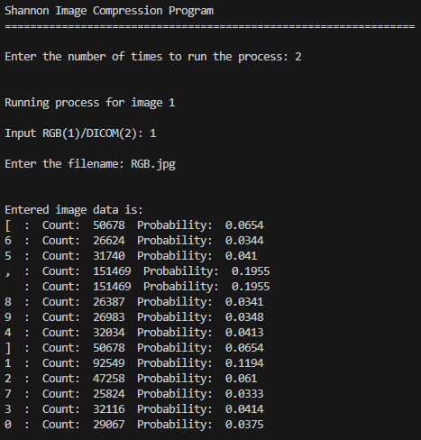
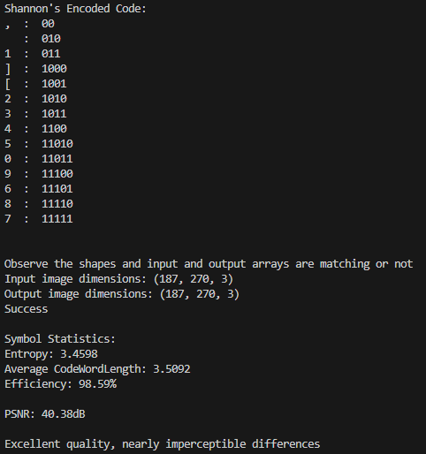
Results and Discussions

Slide 13
Conclusions
In this project, we successfully implemented Shannon-Fano coding for RGB images, showcasing its effectiveness as a lossless compression technique. The analysis revealed substantial efficiency and compression while ensuring that the quality of the images remained intact
We have successfully analysed the results using graphs and charts and also generated the efficiency metrics
We have further extended our project for medical images, and futher in study exploring its capabilities and potential exploring further possibilities

Slide 14
References
https://www.geeksforgeeks.org/shannon-fano-algorithm-for-data-compression/
https://en.wikipedia.org/wiki/Shannon%E2%80%93Fano_coding
Reddy, M. & Akshaya, Koganti & Seles, R. & Dhivya, RA & Ravichandran, Kattur Soundarapandian. (2018). Image Compression using Shannon-Fano-Elias Coding and Run Length Encoding. 1-5. 10.1109/ICICCT.2018.8473120.
Rahman, Md & Mohamed, Mohamed. (2019). Lossless Image Compression Techniques: A State-of-the-Art Survey. Symmetry. 11. 1274. 10.3390/sym11101274.

